Slide 1
What toolbox to build, test ans use an Inforum model?
Update on the current situation
Paul Salmon

Slide 2
Introduction
For at least twenty years, there has been a great deal of progress in all the knowledge that allows us to build, validate and use Inforum models.
This presentation is focused on the tools we use to build our models. The basic tool for all of us is G / Interdyme (G7, Idbuild, Fixer, MacFixer, Interdyme, Compare and Banker) and Excel. You certainly use some others tools you have built or you have selected (text editor, cmd or Powershell, etc.)
Of course, the evolution of the statistical methods in econometrics, the evolution of economic theory, the evolution of national accounts, the evolution of data have an effect on the evolution of our tools. This effect is amplified by the development of computer science and information management system.

Slide 3
Introduction (continued)
Building, validating, and using a model involves organizing all of the processes needed to do all of that work.
Do we need to grow our toolbox? If the answer is yes, what do we need to consider in order to make this wish come true?
Among all the processes, a large part will have to be repeated at different times.
Can we automate them? Or rather, can we automate them even more?
We have many questions on how to do this part of the modeler's job.
Let us try to give some clues.

Slide 4
Be informed about new IT developments and spend time to test them
Much of my professional life has been devoted to teaching programming and setting up information systems.
I therefore had to do what is called technology watch and build examples, cases with students.
Over time, I understood what was useful and what was not.
I had the modeling issues in all of these components constantly on my mind.
How to improve the processes that we have to manage when building, validating and using more or less important models.
This presentation aims to show you what it is possible to do today

Slide 5
What has happened during all these years ?

Slide 7
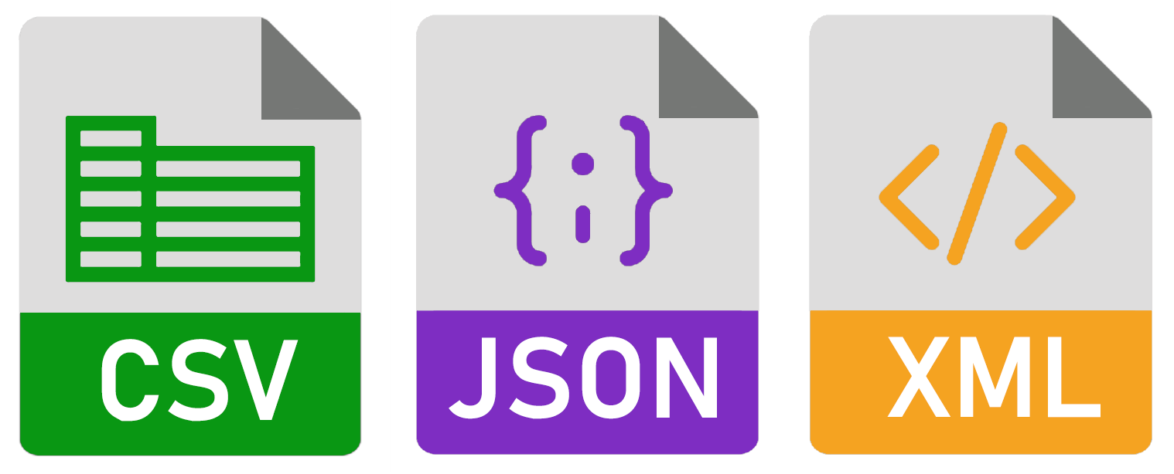
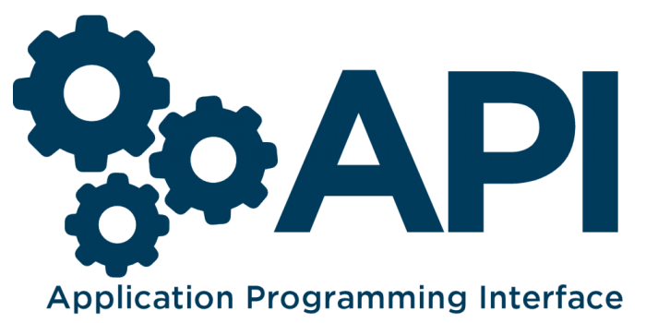
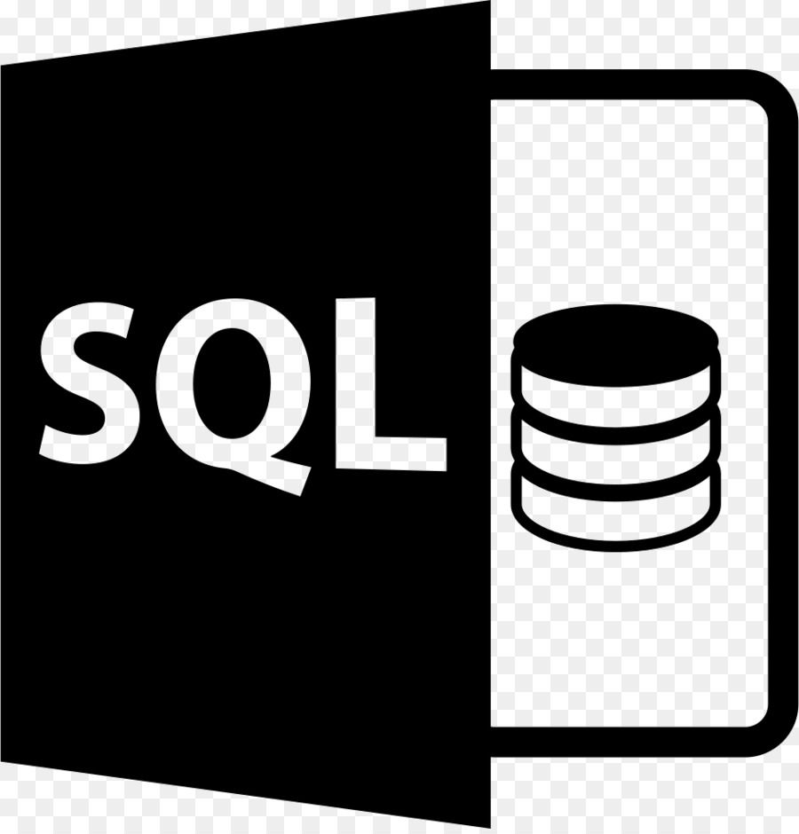
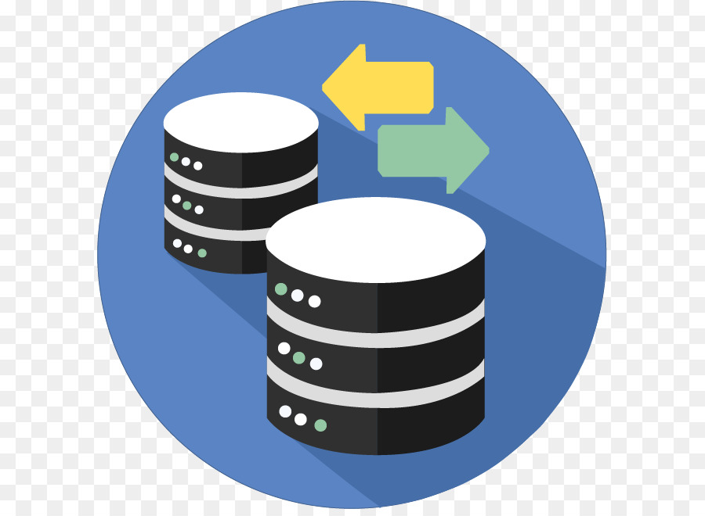
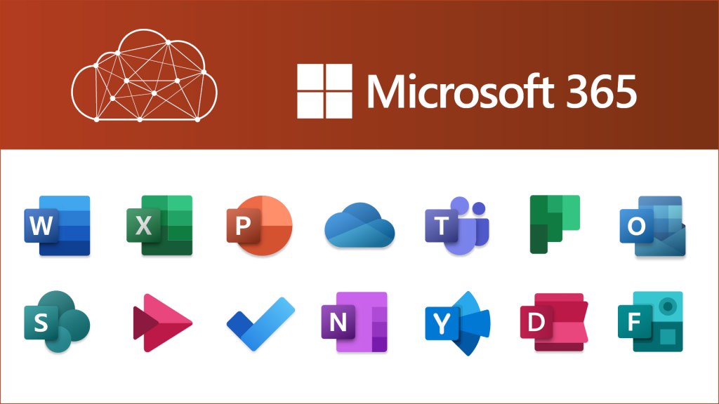
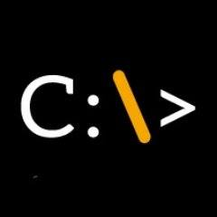

Slide 8
Operating System
Windows
From Windows 10 to Windows 11.
CMD
curl
awk
grep
others
PowerShell
From CMD
Programming
Windows Explorer and other tools.

Slide 9
Programming and programming tools
C++
Python
Embaracadero C++ Builder / RAD 10.4

Slide 10
Internet
Access to the data and all the information we need to work with then.
Ease of downloading files.

Slide 11
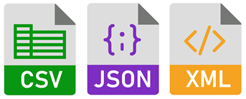
Data

Slide 12
Information Management System/ DataBase
Language
Free products
SQL Language
DDL - Data Manipulation Language
DML - Data Manipulation Language
DQL - Data Control Language
DCL – Data Control Langage
NoSQL (Not Only SQL)
MS SqlServer Express
Ms Sql Server Developer Version
Oracle Express
MySQL
PostgreSql
Etc.

Slide 13
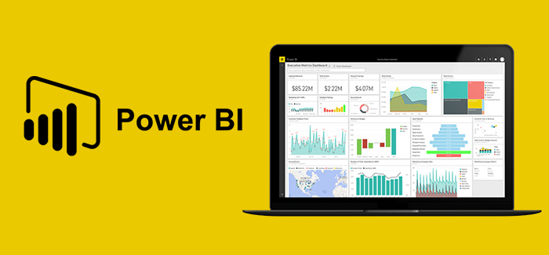
DataVisualization
Tools
D3.js (JavaScript)
Power Bi
Tableau
Excel
Some others
Python
R software
Graphics libraries

Slide 14
DashBoard and Reporting
DashBoard / Reporting
Power Bi
Tableau
Report
Markdown
Word
Libre Office / Open Office

Slide 15
Softwares: their evolutions.
More and more methods
For some of them AI
Graphics / reporting
Using Python, R, VBA, C, C++, …
Improvement to data access and management
Access to Database at least with ODBC / SQL language
Automate
Clouds

Slide 16
Softwares:
SAS
R software
Stata
Eviews
Others
SPSS
WinRats
TSP
Gretl
…

Slide 17
Objective: forecasting / planning
Who use our type of models ?
How enterprise, administration are organized with the numerical transformation ?
The place of forecasting in Entreprise
Financial Planning / Creation Value (Mc Kinsey)
Software
Anaplan
Board

Slide 18
Our toolbox

Slide 19
What is our basic toolbox today?
G
IdBuild
InterDyme
Compare
Excel
Several other tools
C++ Compiler
Text editor

Slide 20
The whole toolbox
Tools for data preparation
G7
Excel
Banker

Slide 21
Data preparation
Download from sources to local machine
Format
CSV / TSV
Fixed format
XML (SDMX)
Json
Xls / xlsx

Slide 22
Tools to prepare data in G7
Excel in G7
Import data to BNK, HBK, VAM (must be verified).
Export data from G to Excel
Graphics
Formula
Other statements
Series
Vectors
Matrices
How to prepare the file ?
Can I treat all kind of files ?

Slide 24
An other organization for Data Preparation

Slide 25
Idbuild and Interdyme
Nothing change

Slide 26
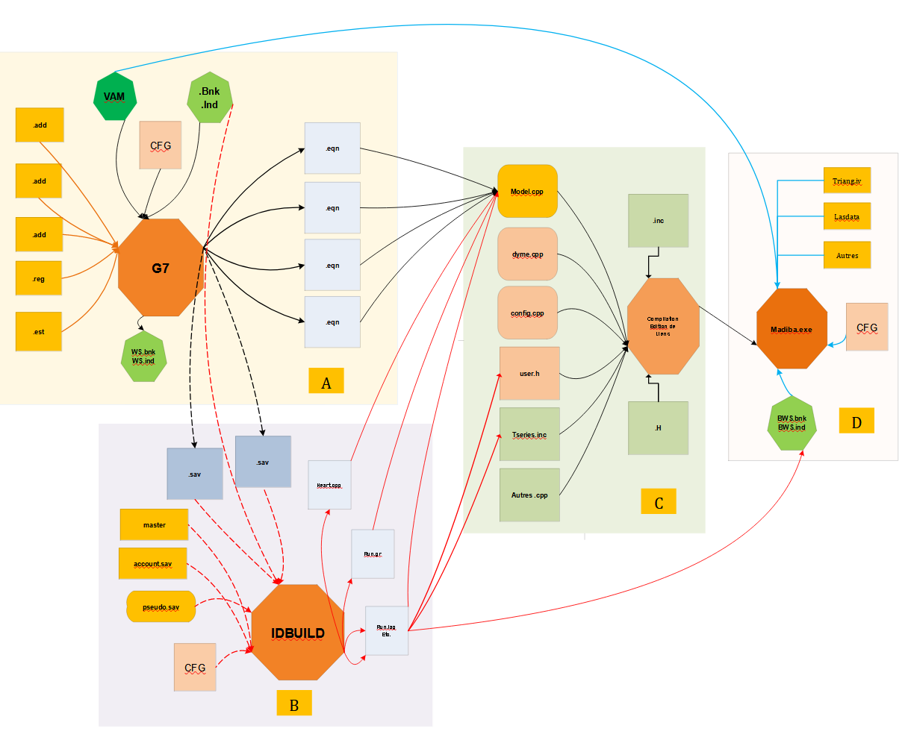

Slide 27
Run the model
No change, but an additional task the transformation of the contents of the data files in G format into tables of the InforumBase database.

Slide 29
Comparison
Actual Organization
Possible organization with DataBase

Slide 30
What can be changed or used with additional tools ?
Our data could be used with a lot of softwares of any kind.
Only one database is sufficient for all our works.
Simplify the management of G bank data files
We have to used the GBankToDB app, everytime we have finsihed a forecast or a simulation.

Slide 31
Automation of dashboards and reportings
Tools like PowerBi or Tableau can be automated either using in-house tools like “Dax” for Power Bi and Power Query or do it using Python for example.
It also possible to run our own application under PowerShell or cmd to obtain a Mardown file which could transform in pdf file, html file or a docx file.

Slide 32
Automation and NoCode or Low code
Automation
Task Scheduler
BPM (Business Process Manager)
No Code or Low Code

Slide 33
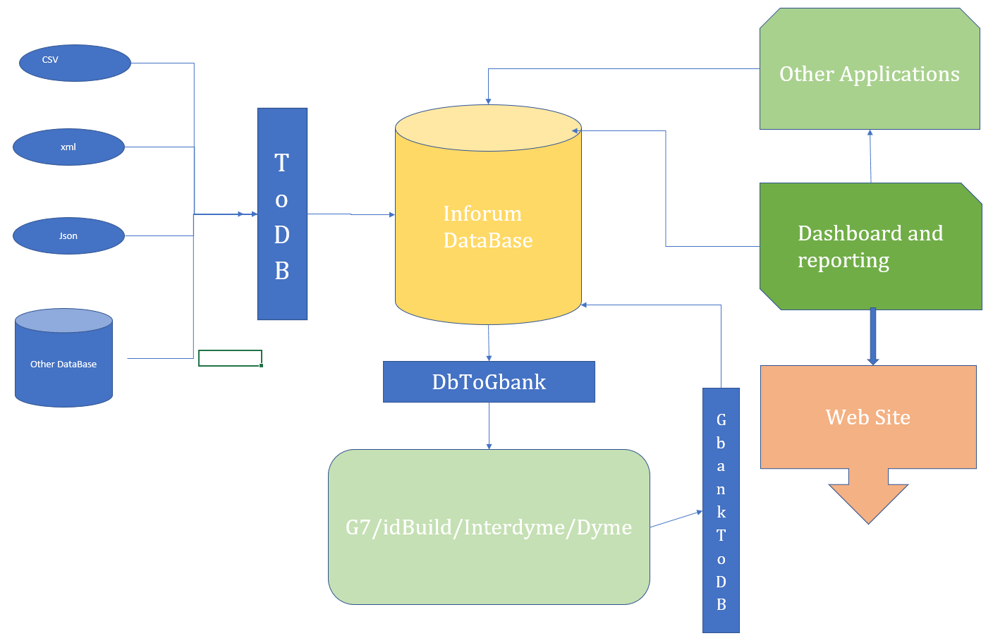
Synthesis

Slide 34
Conclusion.
What we have presented to you is more of a project than a reality, although parts of this project were carried out as a feasibility study.
The idea behind all of this is to see in which work environment we want to evolve.
We all already have our own working environment. Do we want to change it, improve the one that is ours today?
There is no obligation to change.
To do so means forcing ourselves to learn new tools, to change our habits.
I believe despite heavy constraints that it should be done simply to have time after setting up to have appreciable time savings to do other than the computer can not do.

Slide 35
Thank you for your attention

